Slide 1






Climate Knowledge Hunt
#SemanticClimate’s Climate Knowledge Hunt
September 24th, 2022
Shweata N. Hegde
Volunteer developer at #SemanticClimate
Co-founder of science podcast, IndiaAsksWhy

Slide 2

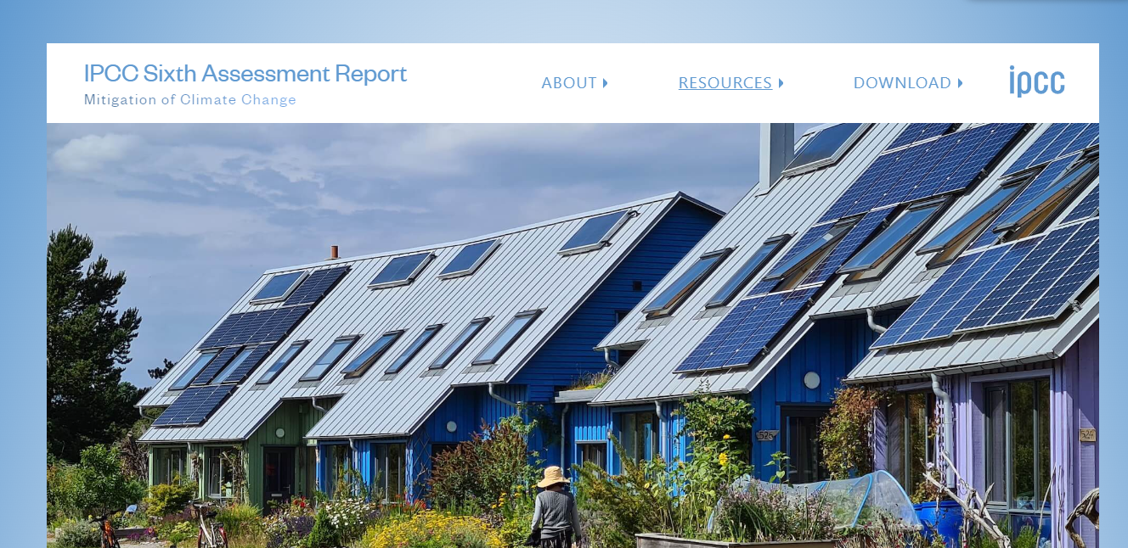

Information to save the world is locked in PDF reports
I can’t read all of that!
#SemanticClimate’s Climate Knowledge Hunt
IPCC Reports
But it’s the most important document ever
3000 pages;
technical
not editable
Text Data-Mining can help!

Slide 3

Machines can help, but…
They can’t make sense of PDFs
#SemanticClimate’s Climate Knowledge Hunt
We need tools!
Really?
Hey, #SemanticClimate can help!

Slide 4

How our TDM tools liberate knowledge
pyami
< >
HTML
docanalysis
…despite mitigation efforts 8 including those in near-universal nationally determined contributions (NDCs)…
#SemanticClimate’s Climate Knowledge Hunt
IPCC chapters,
IPBES reports,
…
docanalysis
Hegde SN, Garg A, Murray-Rust P, Mietchen D (2022) Mining the literature for ethics statements: a step towards standardizing research ethics. ARPHA Preprints. https://doi.org/10.3897/arphapreprints.e94687
pyami
Peter Murray-Rust

Slide 5
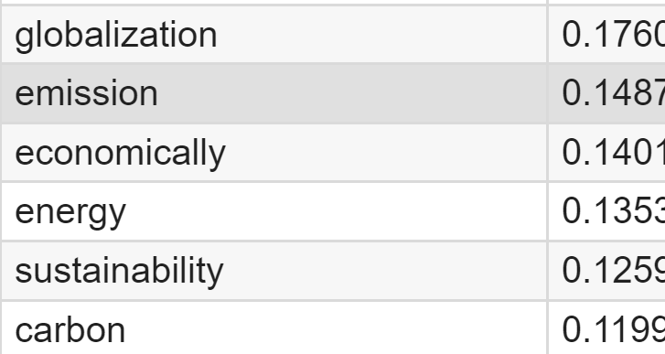
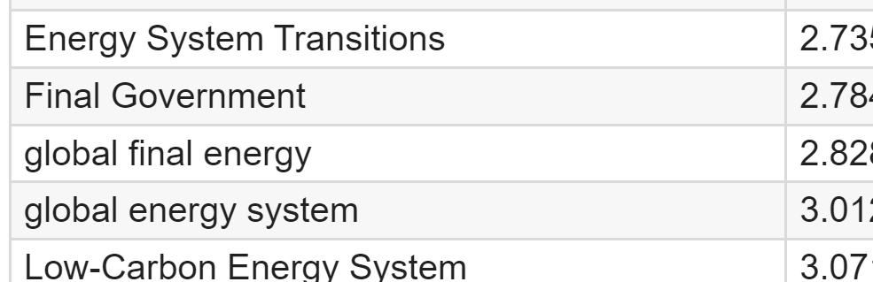
extracts keywords, abbreviations
docanalysis
1
Keyword | score
Converted HTML
< >
HTML
Extract keywords using state-of-the-art tools
#SemanticClimate’s Climate Knowledge Hunt
Key-phrases |score
1
Gensim
2
2
Yake
Keyphrase extraction work by Ananya Singha

Slide 6

How our TDM tools liberate knowledge
Climate-related terms dictionary
pyami
docanalysis
…despite mitigation efforts 8 including those in near-universal nationally determined contributions (NDCs)…
< >
HTML
#SemanticClimate’s Climate Knowledge Hunt
IPCC chapters,
IPBES reports,
…
Abbreviation dictionary

Slide 7
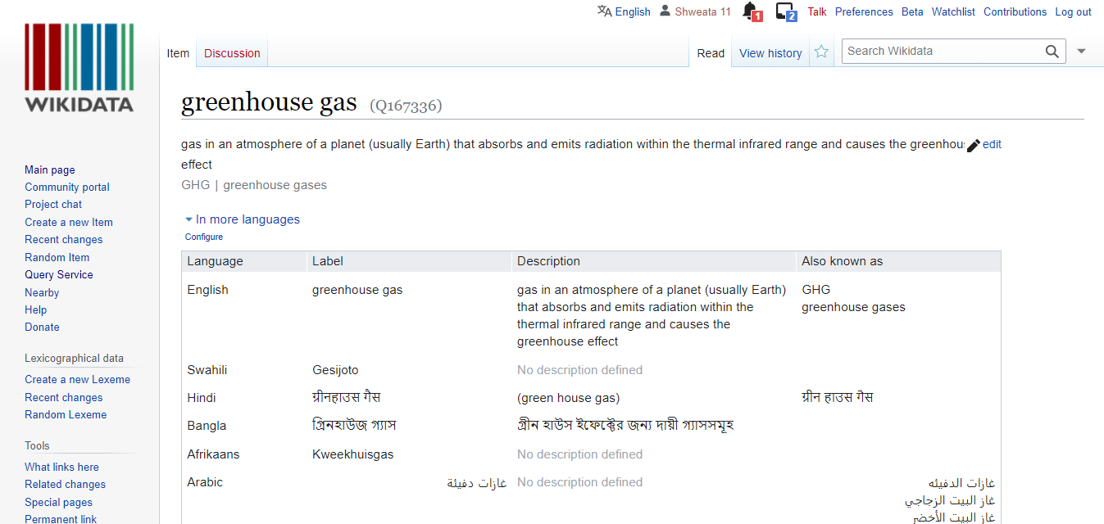
Dictionary
Set of terms with unique Wikidata Identifiers
<entry name="VRE" term="Variable Renewable Energy" wikidataID=“Q7915732”/>
<entry name=“NDC" term=“Nationally Determined Contributions" wikidataID=“Q20051297”/>
<entry name=“GHG" term=“Greenhouse Gas" wikidataID=“Q167336”/>
#SemanticClimate’s Climate Knowledge Hunt
In different languages!

Slide 8
How our TDM tools liberate knowledge
Climate-related terms dictionary
pyami
docanalysis
…despite mitigation efforts 8 including those in near-universal nationally determined contributions (NDCs)…
< >
HTML
#SemanticClimate’s Climate Knowledge Hunt
IPCC chapters,
IPBES reports,
…
Abbreviation dictionary

Slide 9
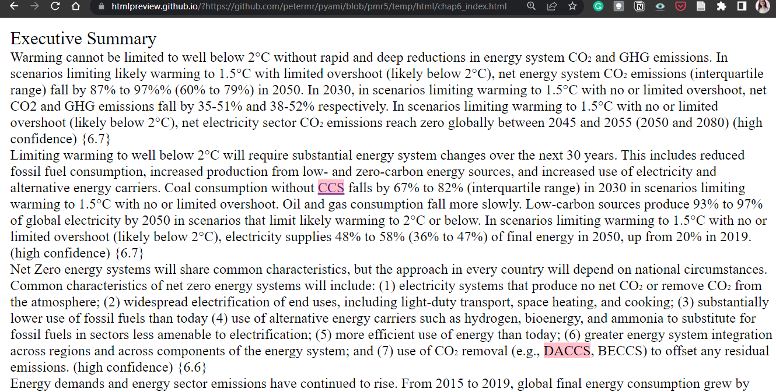
#1 Learn what abbreviations mean, instantaneously!
#SemanticClimate’s Climate Knowledge Hunt

Slide 10
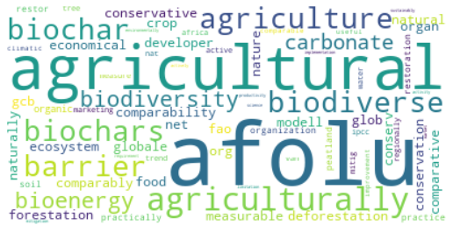
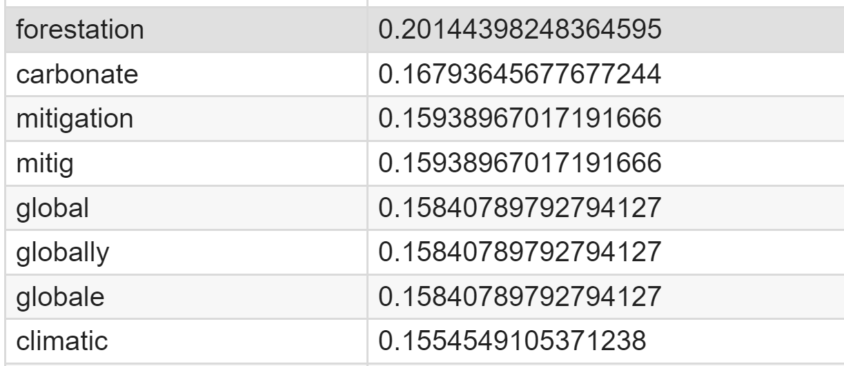
# 2 Which terms commonly occur in a chapter?
< >
HTML
Keyword extraction
Keyword | score
TF-IDF Model
#SemanticClimate’s Climate Knowledge Hunt
Work by Ananya Singha

Slide 11
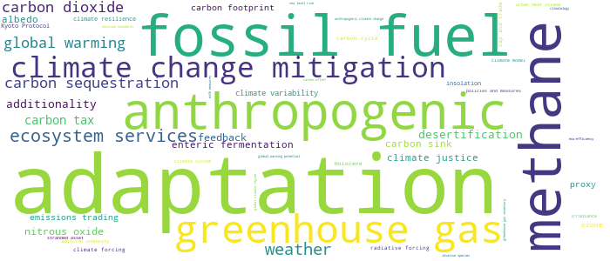
#3 See the big picture using dictionaries!
Demo link
{'adaptation': 286, 'fossil fuel': 111, 'methane': 107, 'anthropogenic': 83, 'greenhouse gas': 81, 'climate change mitigation': 66, 'ecosystem services': 48, 'weather': 44, 'carbon sequestration': 35, 'global warming ': 33, 'carbon dioxide': 33, 'carbon tax': 21, 'desertification’: …}
#SemanticClimate’s Climate Knowledge Hunt
docanalysis
From 6 chapters of IPCC

Slide 12
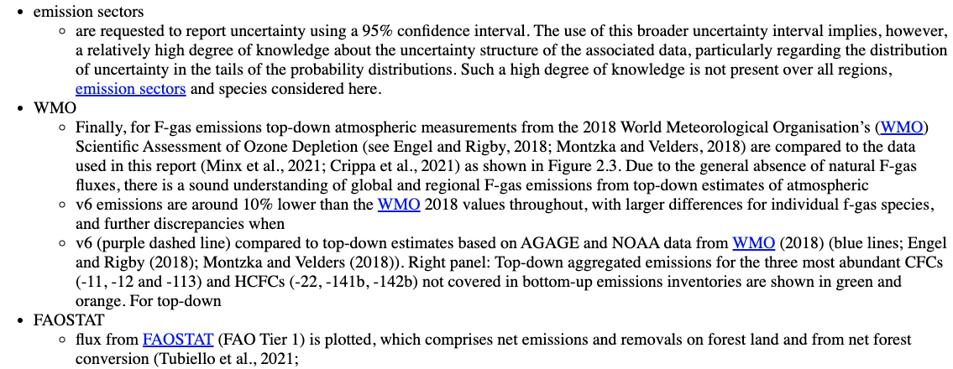
#4 Know which sections are relevant to YOU!
Indexing
Term
Sentences that mention the term -- WMO
#SemanticClimate’s Climate Knowledge Hunt

Slide 13
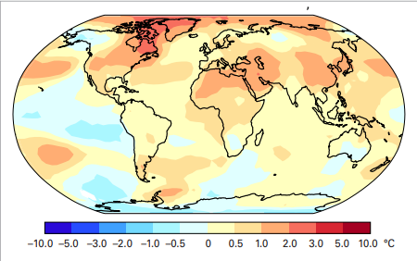
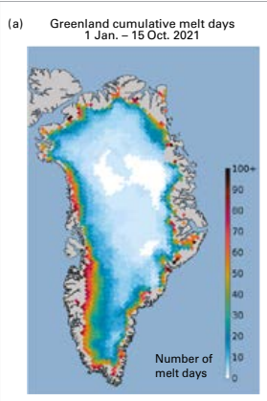
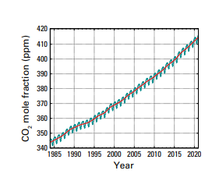
#5 Index > 1000 images reports
Pull text from images!
#SemanticClimate’s Climate Knowledge Hunt
https://library.wmo.int/doc_num.php?explnum_id=11178

Slide 14
#SemanticClimate’s TDM tools empower, you, the reader
Learn what abbreviations and phrases mean, instantaneously
See the big picture
Know which documents and sections are relevant
#SemanticClimate’s Climate Knowledge Hunt

Slide 15
Deep dive into our tools
#SemanticClimate’s Climate Knowledge Hunt
Nothing to be frightened of!

Slide 16



#SemanticClimate’s Climate Knowledge Hunt
We develop tools in Python using state-of-art NLP, AI and machine learning tools – spaCy, nltk, genism, etc.
We openly share tools and, and store data on GitHub
We showcase our tool in Google Colab
Open Notebook Philosophy
Notes:
This Photo by Unknown Author is licensed under CC BY
This Photo by Unknown Author is licensed under CC BY-SA
This Photo by Unknown Author is licensed under CC BY-SA-NC

Slide 17
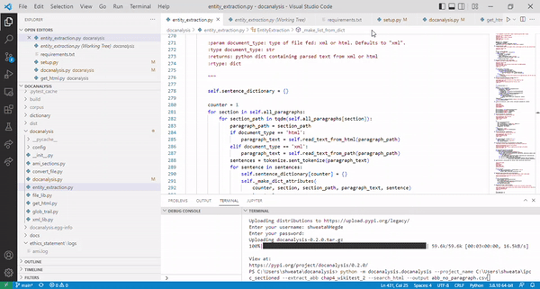
You don’t have see or work with this!
#SemanticClimate’s Climate Knowledge Hunt
Python

Slide 18
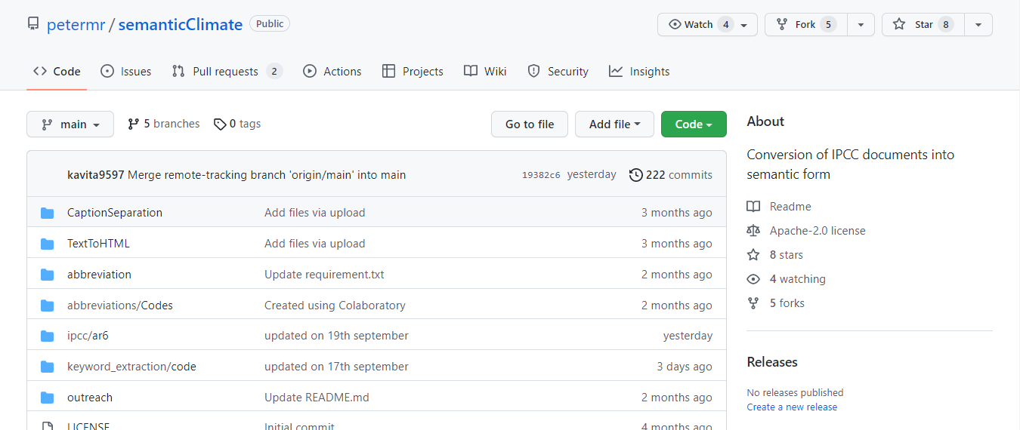
Our dictionaries and code are all openly available for anybody to browse and re-use
#SemanticClimate’s Climate Knowledge Hunt
GitHub
pyami
https://github.com/petermr/pyami
pyamiimage
https://github.com/petermr/pyamiimage
docanalysis
https://github.com/petermr/docanalysis
pygetpapers
https://github.com/petermr/pygetpapers
SemanticClimate
https://github.com/petermr/semanticClimate

Slide 19
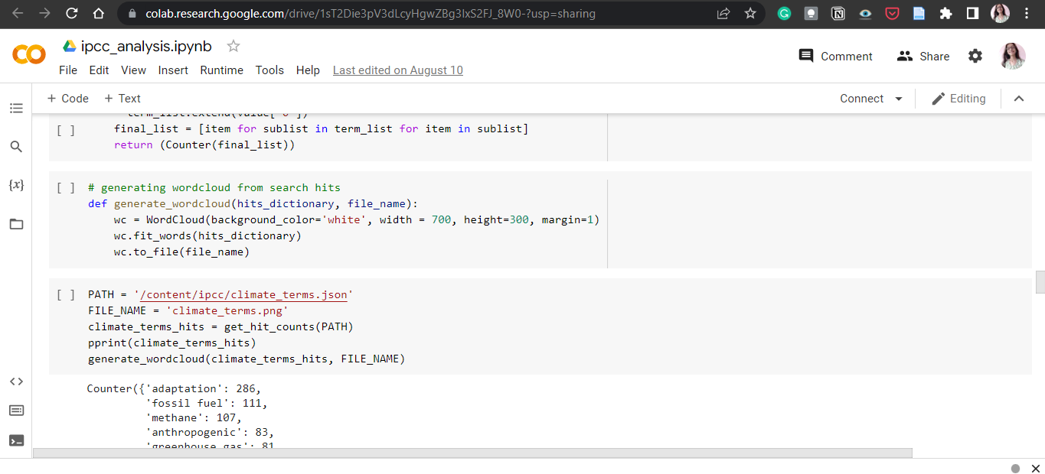
Experiment with our tools!
#SemanticClimate’s Climate Knowledge Hunt
Run our tools with a click of button on your browser!

Slide 20
What in next two hours?
#SemanticClimate’s Climate Knowledge Hunt
Learning by doing

Slide 21
WHAT NEXT?
First-half
- Choose breakout room based on your interest and pitch from chapter champions
Run Colab Notebooks in breakouts
Second-half
move to another existing Chapter breakout room (e.g. Chapter02 to Chapter07)
hands-on doing a new Chapter (with supervision)
Meet the developers – explore tools, give feedback
#SemanticClimate’s Climate Knowledge Hunt

Slide 22
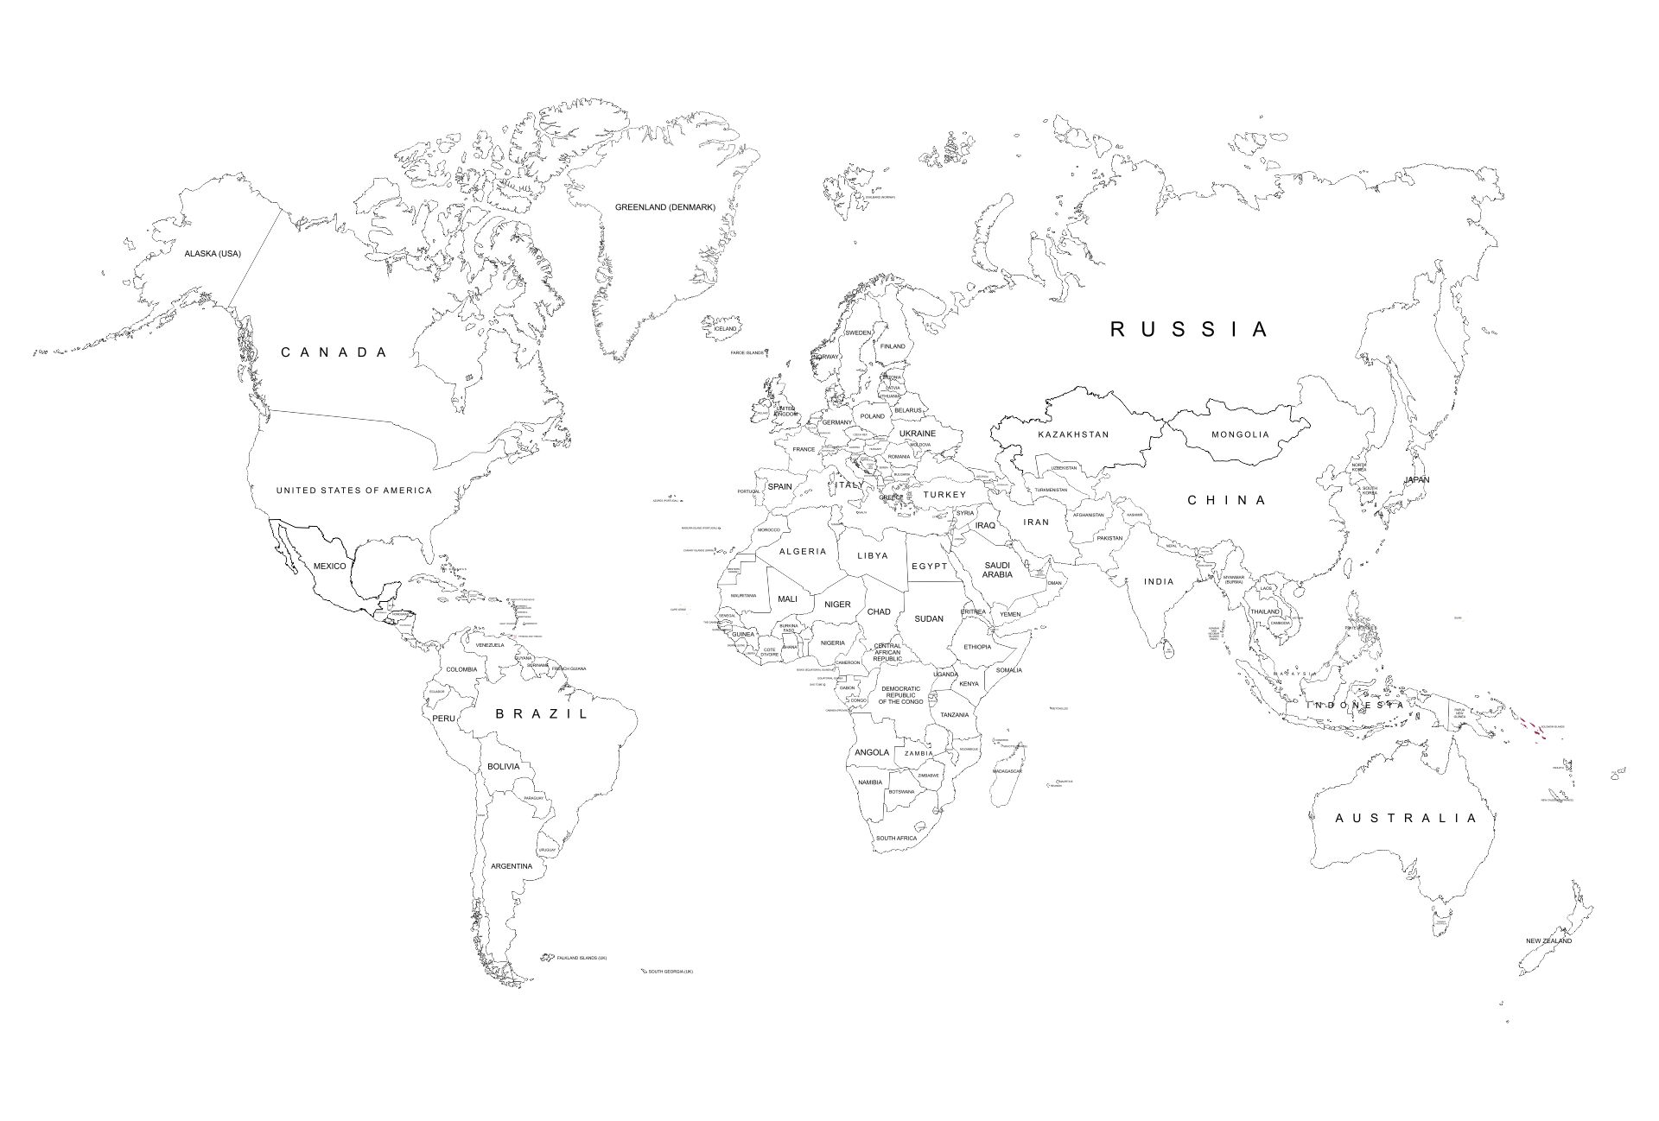

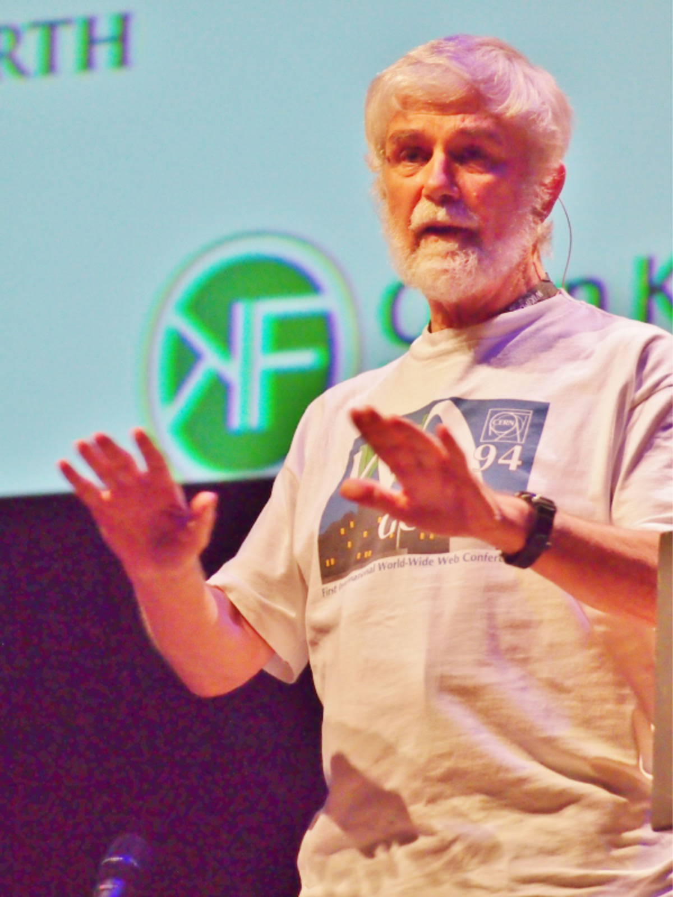

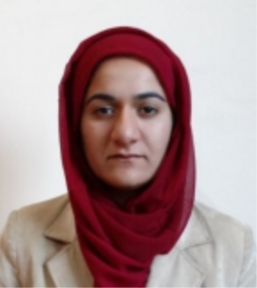

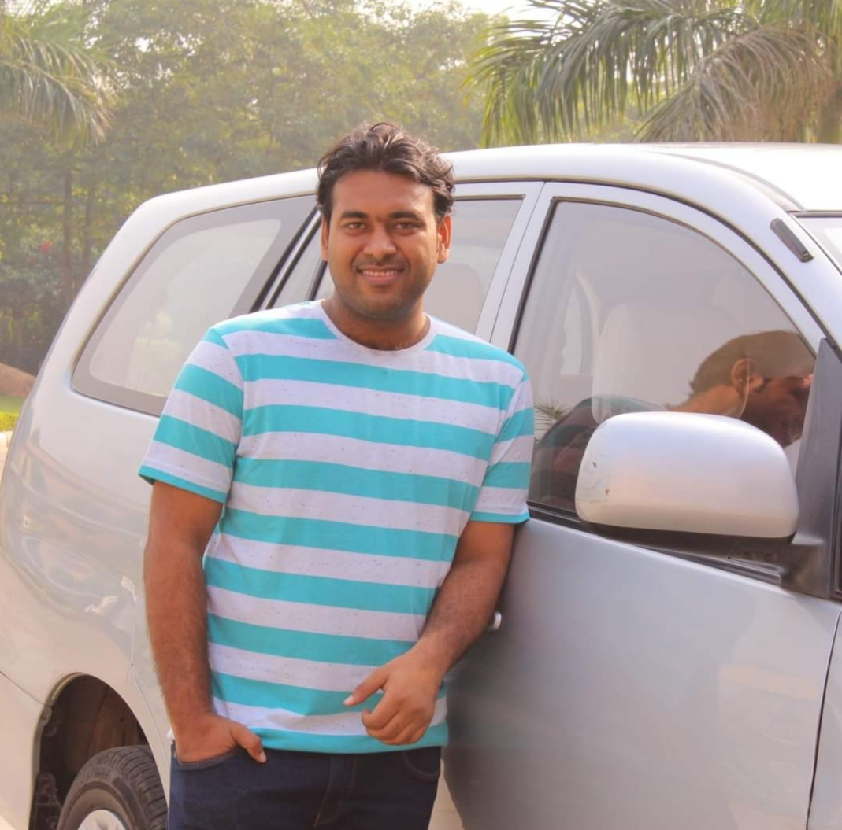


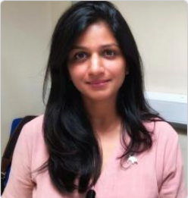

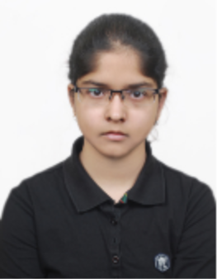



Join the diverse team!
#SemanticClimate’s Climate Knowledge Hunt

Slide 23
Over to Chapter Champions…
Chapter 2
Chapter 7
Chapter 8
#SemanticClimate’s Climate Knowledge Hunt
Abhishek Prasad,
Ph.D. Student
Priti Chahal,
M.Sc. Bioinformatics
Kavita Joshi,
Ph.D. Student

